Slide 1
PIZZA – SALES-SQL
Presented by Mital Vejani
Data Analyst

Slide 2
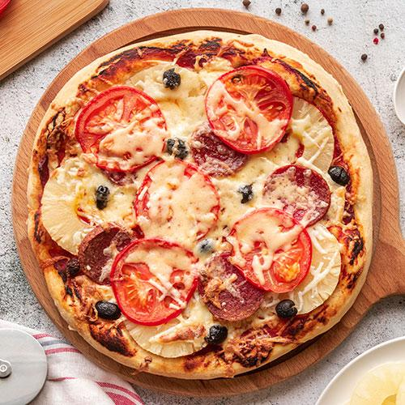

Introduction
Hello everyone, my name is Mital Vejani,
I’m a Data Analyst with a passion for uncovering insights from data.
In this project, I’ve undertaken a detailed analysis of pizza sales, utilizing SQL from basic to advanced levels.
This presentation will walk you through the methods and insights gained from this analysis, showcasing how SQL can be a powerful tool for driving data-driven decisions.

Slide 3
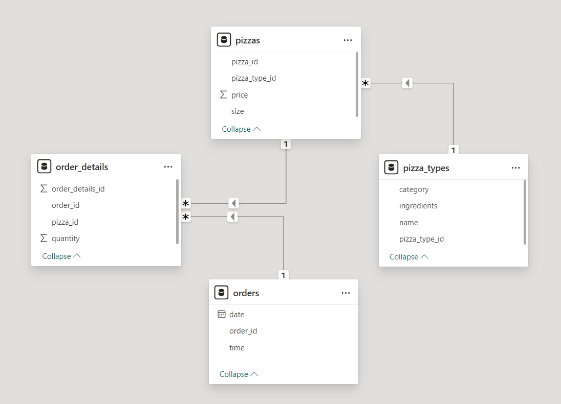
Data Model

Slide 4
Skills Applied
Imported data from a CSV file into MySQL Workbench.
Utilized Joins to combine data from multiple tables.
Applied Group By to aggregate data for insightful analysis.
Used Order By to sort data for better clarity.
Implemented Subqueries to solve complex questions.

Slide 5

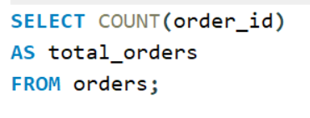
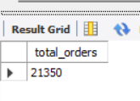
Retrieve the total number of orders placed

Slide 6
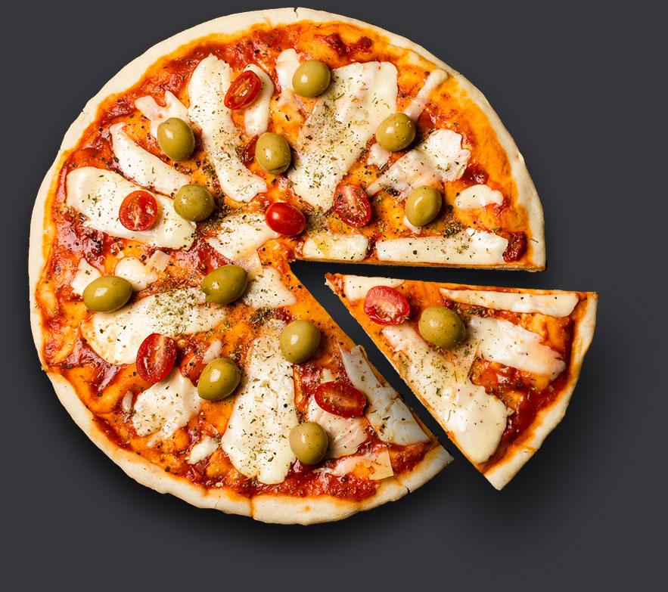
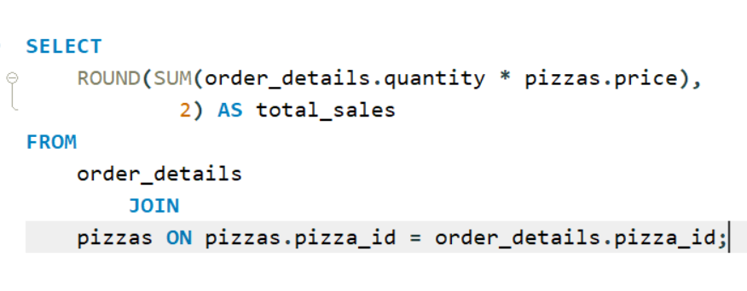
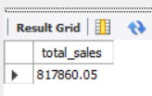
Calculate the total revenue generated from pizza sales

Slide 7
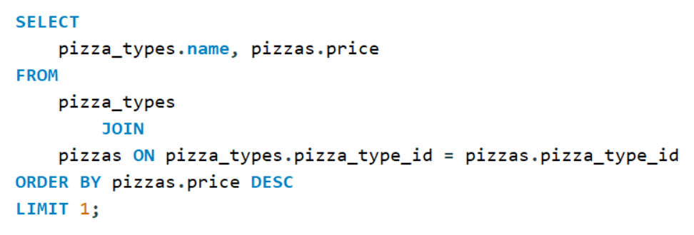
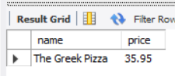
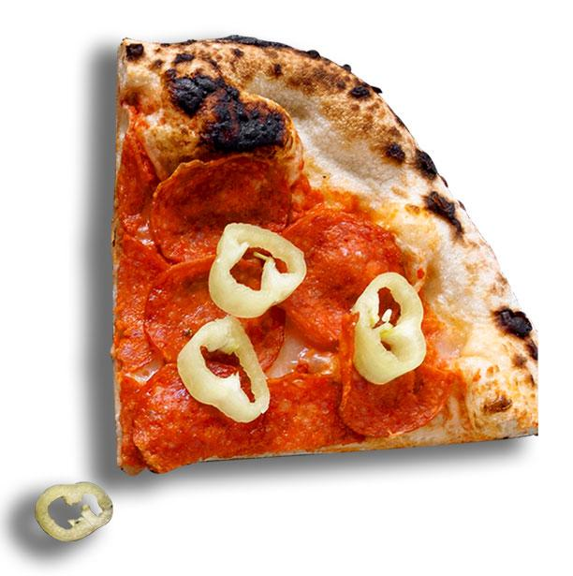
Identify the highest-priced pizza

Slide 8
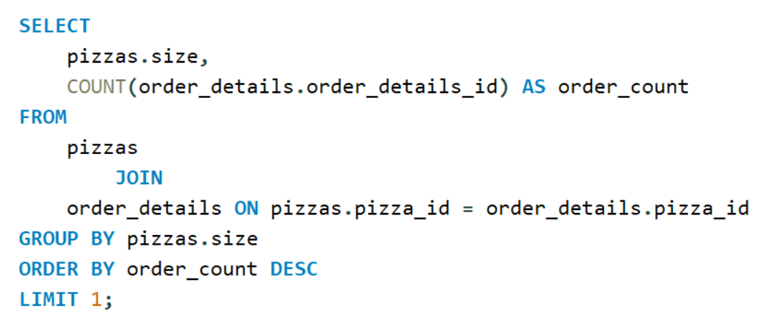
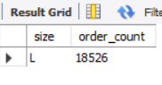
Identify the most common pizza size ordered

Slide 9
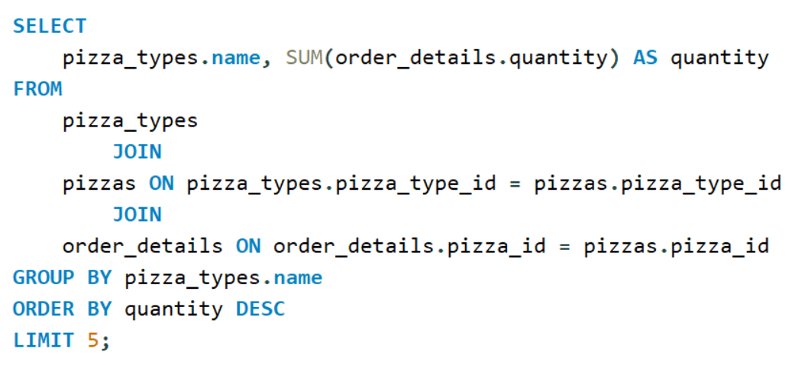
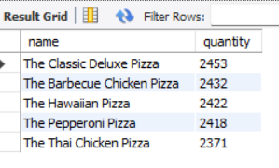
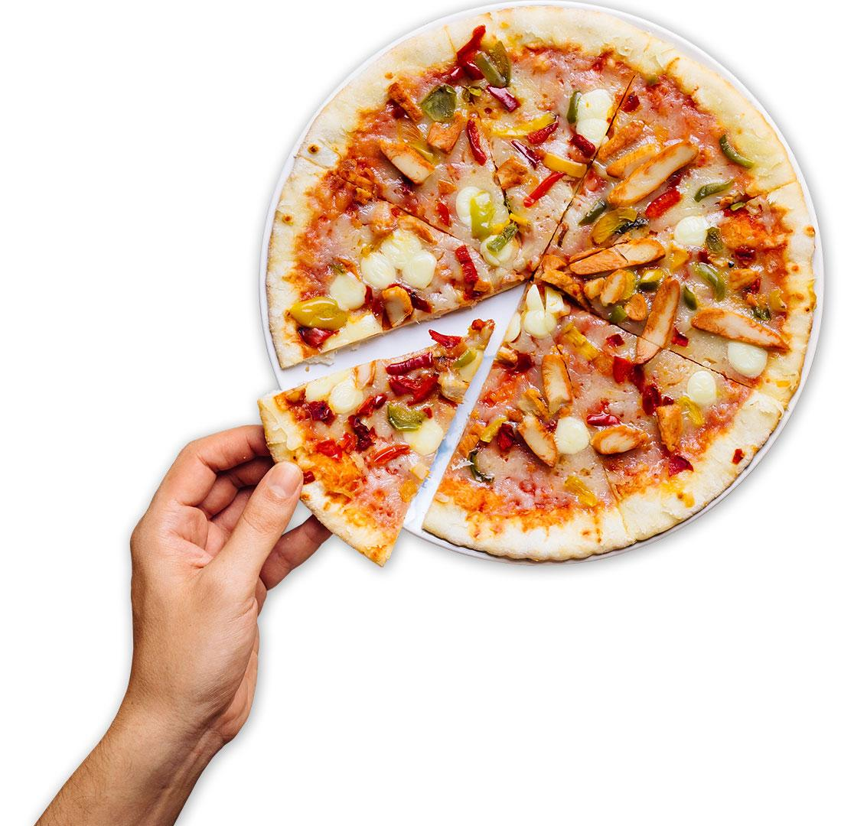
List the top 5 most ordered pizza types along with their quantities

Slide 10

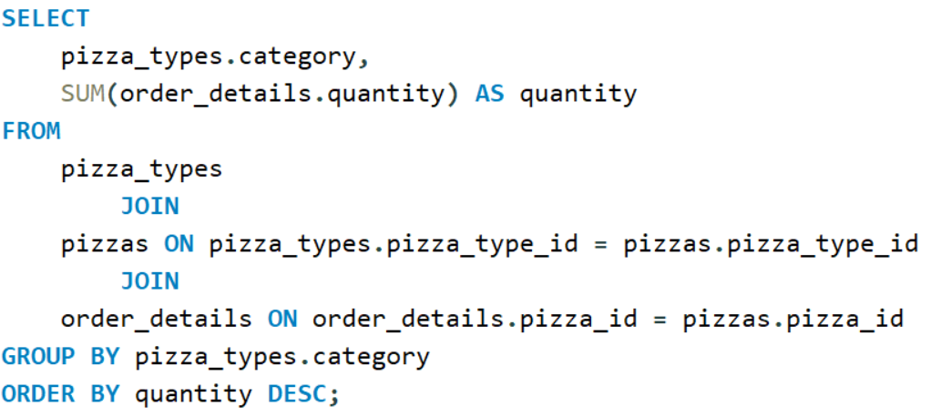
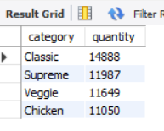

Join the necessary tables to find the total quantity of each pizza category ordered

Slide 11
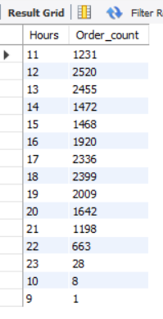
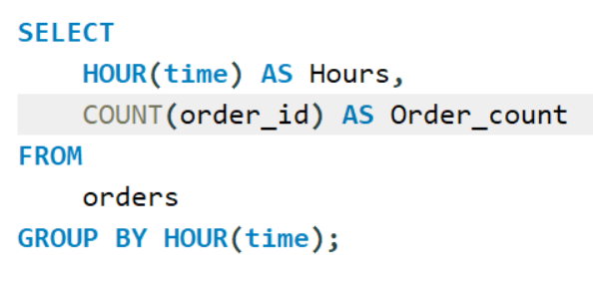
Determine the distribution of orders by hour of the day

Slide 12
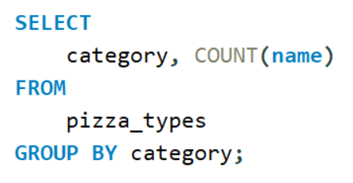
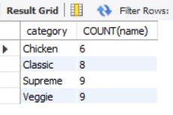
Join relevant tables to find the category-wise distribution of pizzas

Slide 13
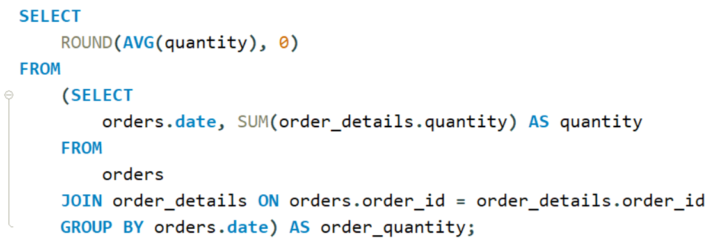
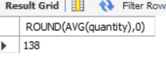

Group the orders by date and calculate the average number of pizzas ordered per day

Slide 14
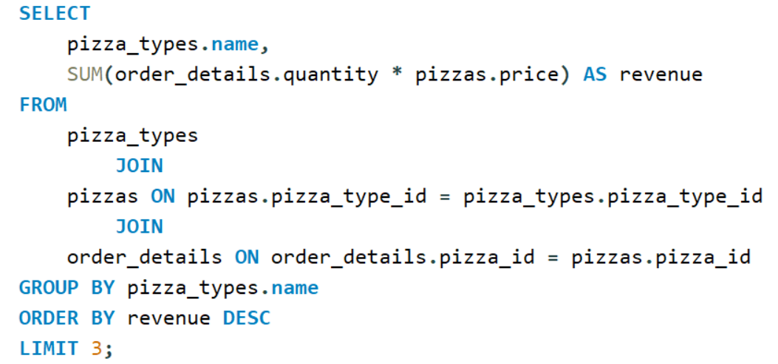
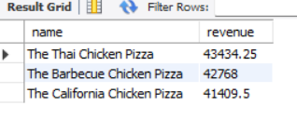
Determine the top 3 most ordered pizza types based on revenue

Slide 15
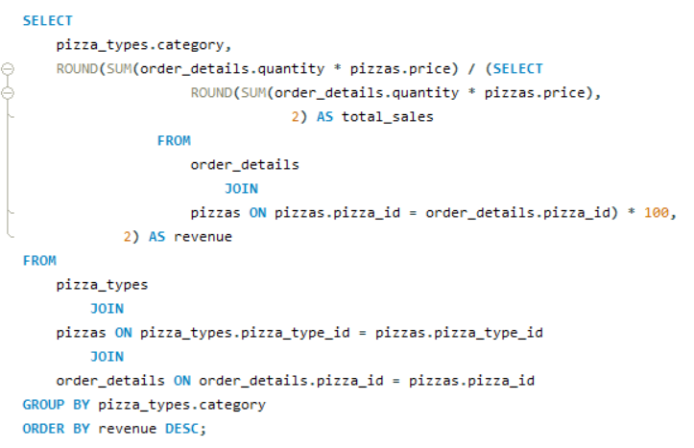
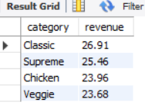
Calculate the percentage contribution of each pizza type to total revenue

Slide 16
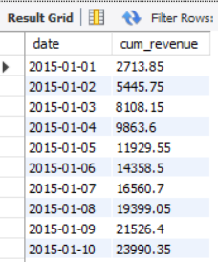
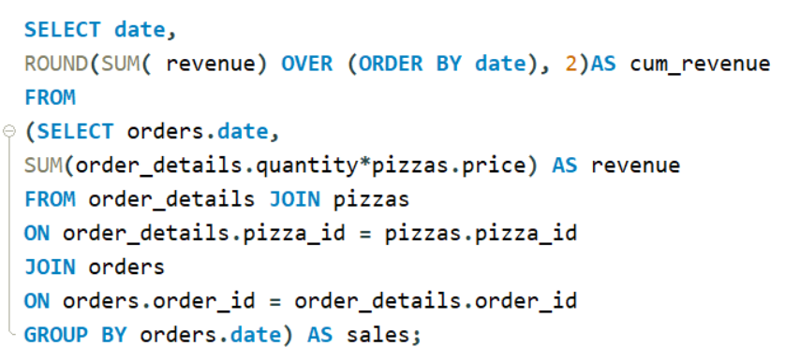
Analyze the cumulative revenue generated over time

Slide 17
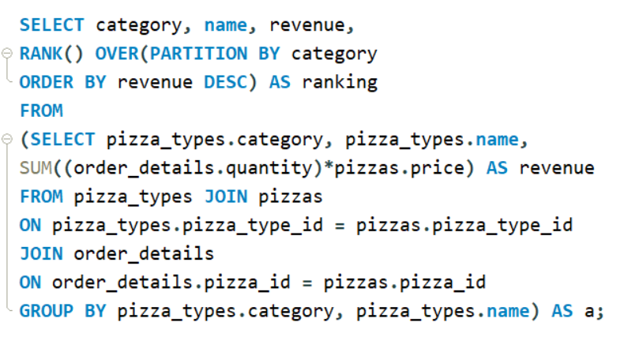
Determine the top 3 most ordered pizza types based on revenue for each pizza category

Slide 18
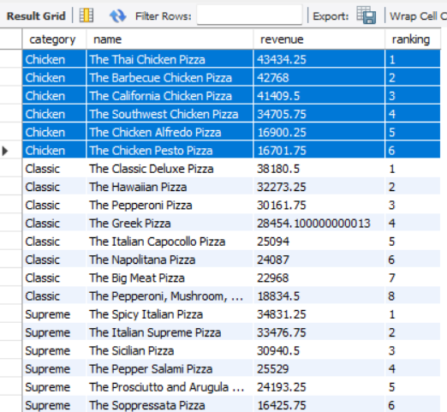
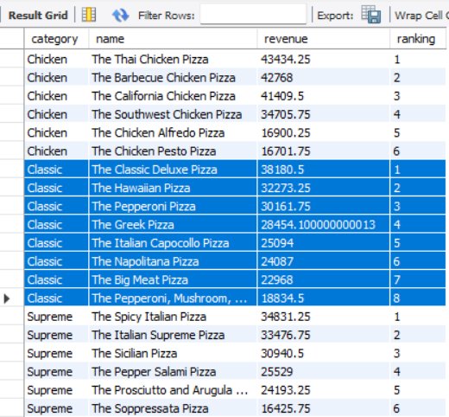
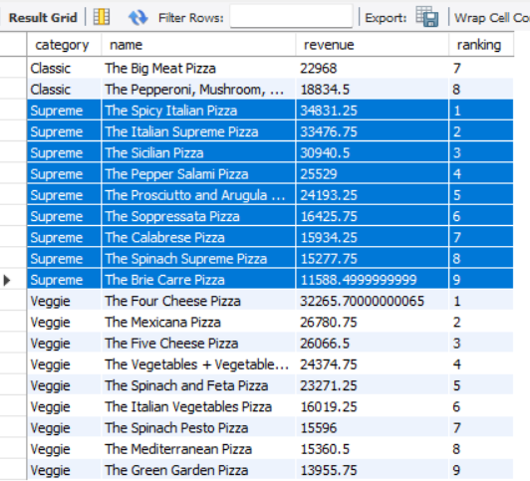

Slide 19
Thanks!
Mital Vejani
mitalvejani@gmail.com

